Slide 1
Front-line treatment for patients with EGFR tumor mutations
Gregory J. Riely
March 3 2018

Slide 2
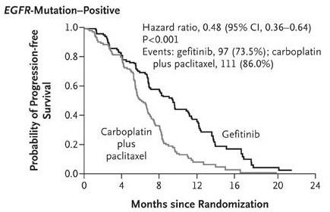
In Patients with EGFR mutant NSCLC, EGFR TKI are better than platinum-doublet chemotherapy
Mok TS, et al. N Engl J Med. 2009;361(10):947-957.
Mok et al NEJM 2009

Slide 3
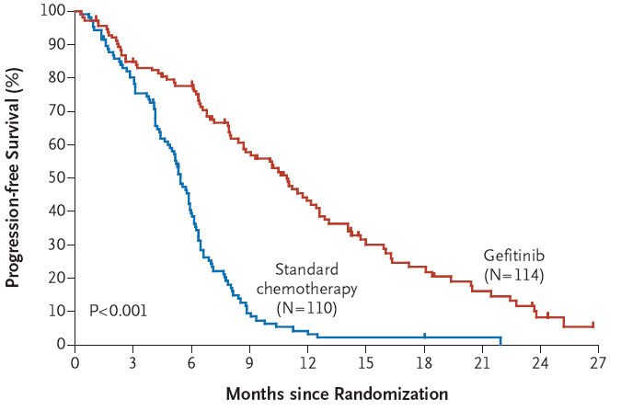
All patients will develop acquired resistance to EGFR TKI
Median 10.8 vs 5.4 months, HR 0.30,
Maemondo, NEJM 2010

Slide 4
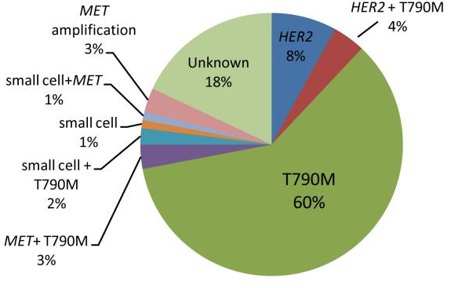
Mechanisms of Acquired Resistance to 1st/2nd Generation EGFR Tyrosine Kinase Inhibitors
Yu et al, CCR 2013

Slide 5
Spectrum of Activity of EGFR TKIs
 | Drug | EGFR L858R | EGFR Exon 19 del | EGFR T790M | EGFR
1st gen | gefitinib | + | + | - | +
 | erlotinib | + | + | - | +
2nd gen | afatinib | + | + | - | +
3rd gen | osimertinib | + | + | + | -

Slide 6
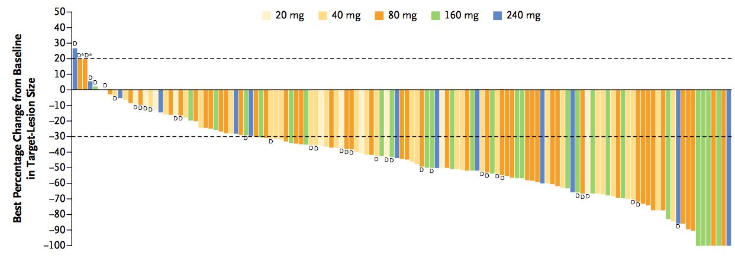
Osimertinib in Patients With Acquired Resistance to EGFR TKI and EGFR T790M
Response Rate = 61%

Slide 7
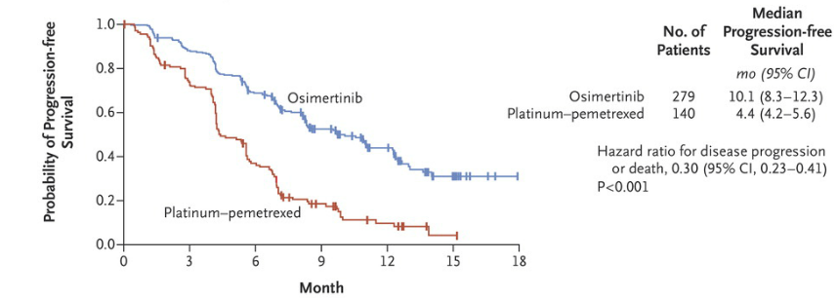
Osimertinib is superior to platinum-based chemotherapy for patients with EGFR T790M
Mok et al, NEJM 2016

Slide 8
How we treat EGFR mutant patients
~10 months Median PFS with osimertinib
Diagnosis
9-11 month
Median PFS
1st Gen

Slide 9
How we treat EGFR mutant patients
~10 months Median PFS with osimertinib (T790M +)
Diagnosis
9-11 month
Median PFS
1st Gen
~4 months Median PFS with Chemotherapy

Slide 10
How we treat EGFR mutant patients
~10 months Median PFS with osimertinib (T790M +)
Diagnosis
9-11 month
Median PFS
1st Gen
~4 months Median PFS with Chemotherapy
Diagnosis
?
Start with osimertinib?

Slide 11
Osimertinib vs Gefitinib/Erlotinib Randomized Trial (FLAURA)
Osimertinib
(80 mg p.o. qd)
(n=279)
Patients with locally advanced or metastatic NSCLC
Stratification by mutation status (Exon 19 deletion / L858R)
and race (Asian / non-Asian)
Key inclusion criteria
WHO performance status 0 / 1
Exon 19 deletion / L858R
No prior systemic anti-cancer / EGFR-TKI therapy
Stable CNS metastases allowed
EGFR-TKI SoC;
Gefitinib (250 mg p.o. qd) or Erlotinib (150 mg p.o. qd)
(n=277)
Primary endpoint: PFS
Secondary endpoints: response rate, duration of response, disease control rate, depth of response, overall survival, patient reported outcomes, safety
Soria et al, NEJM 2017

Slide 12
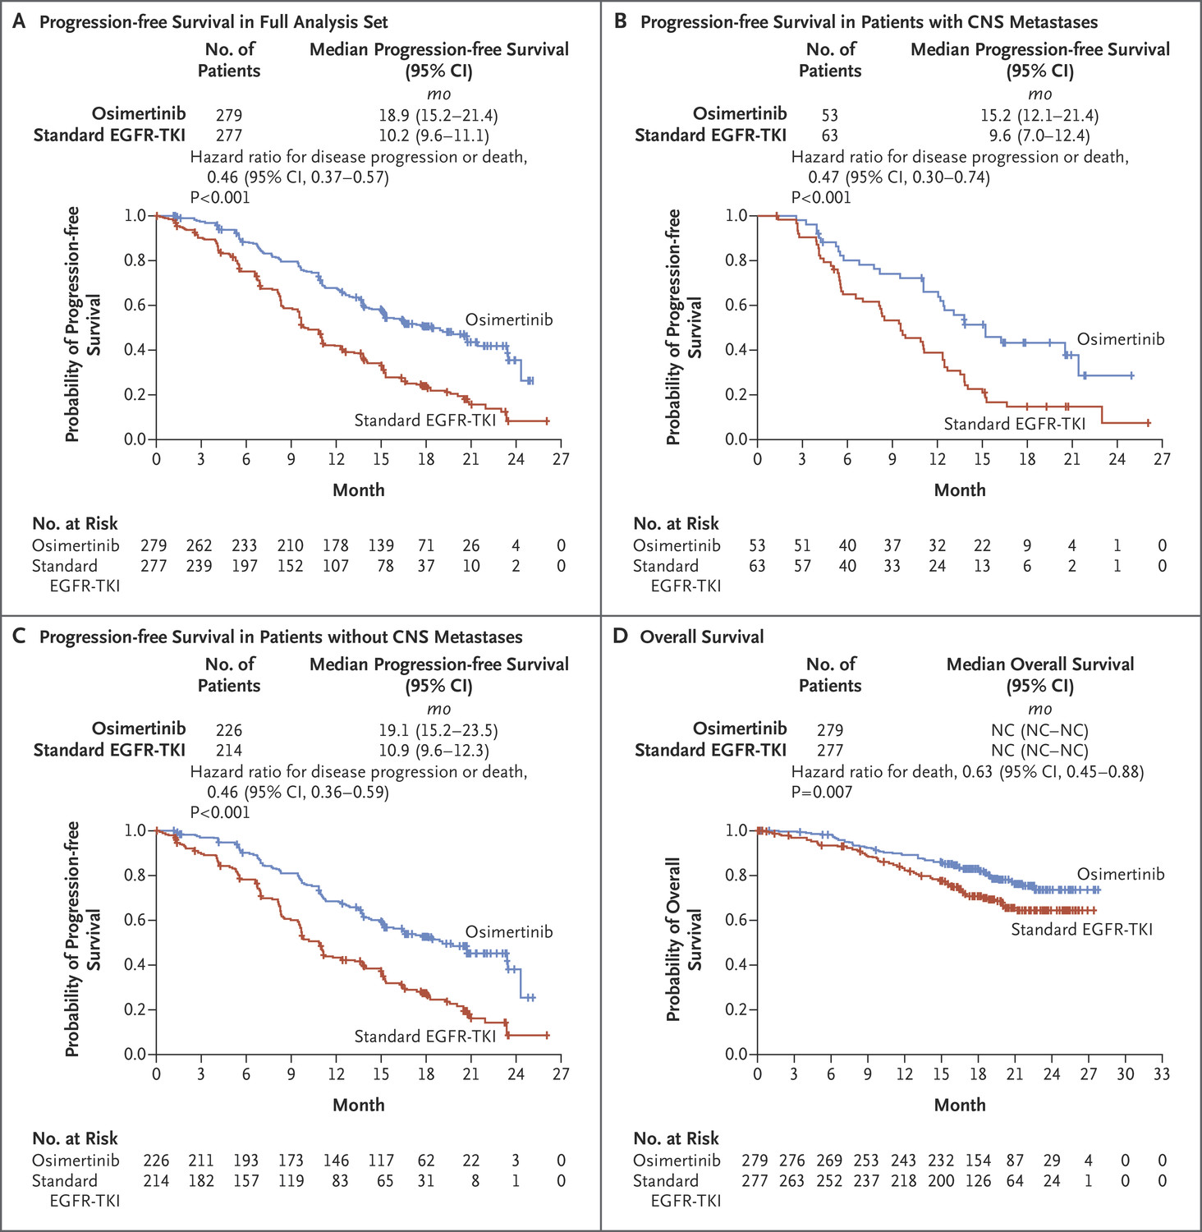
Osimertinib vs Gefitinib/Erlotinib Progression-Free Survival
Soria, NEJM 2017

Slide 13
Osimertinib vs Gefitinib/Erlotinib Toxicity Summary
AE, any cause, n (%) | Osimertinib (n=279) | SoC (n=277)
Any AE | 273 (98) | 271 (98)
Any AE Grade ≥3 | 94 (34) | 124 (45)
Any AE leading to death | 6 (2) | 10 (4)
Any serious AE | 60 (22) | 70 (25)
Any AE leading to discontinuation | 37 (13) | 49 (18)
AE, possibly causally related, n (%)
Any AE | 253 (91) | 255 (92)
Any AE Grade ≥3 | 49 (18) | 78 (28)
Any AE leading to death | 0 | 1 (<1)
Any serious AE | 22 (8) | 23 (8)
Soria, NEJM 2017

Slide 14
How we treat EGFR mutant patients
~10 months Median PFS with osimertinib (T790M +)
Diagnosis
9-11 month
Median PFS
1st Gen
~4 months Median PFS with Chemotherapy
Diagnosis
?
Start with osimertinib?

Slide 15
Osimertinib vs Gefitinib/Erlotinib Overall Survival
Hazard ratio – 0.63 (95% CI, 0.45-0.88)
p=0.007
Soria, NEJM 2017

Slide 16
Conclusions: EGFR mutant NSCLC
For patients with EGFR mutant NSCLC, first line therapy with osimertinib leads to longer progression free survival and may improve overall survival
Adverse event profile may be slightly better for first-line osimertinib
Caveat: Mechanisms of resistance to first-line osimertinib are largely unknown at this time

Slide 17
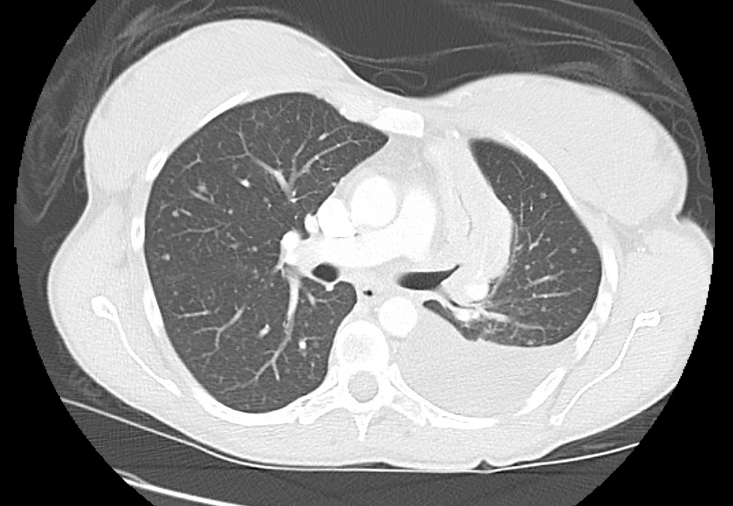
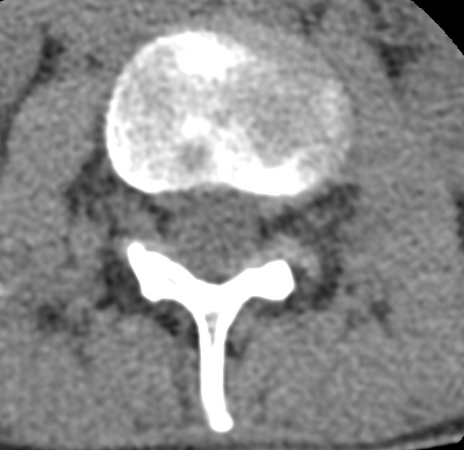
Case
38 year old never smoker woman with back pain for one year, developed shortness of breath. Initial chest x-ray showed pleural effusion and the patient had a CT chest that showed large pleural effusion and an CT spine that showed multiple lesions.

Slide 18
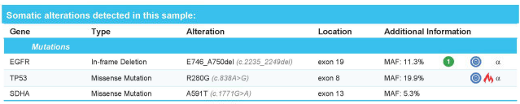
Case
MRI brain unremarkable
After thoracentesis, cytology from pleural effusion showed:
Napsin A positive adenocarcinoma.
PD-L1 10%.
Molecular testing showed EGFR exon 19 deletion

Slide 19
What’s the best initial therapy for this patient with metastatic EGFR mutant NSCLC?
Erlotinib
Pembrolizumab
Osimertinib
Carboplatin/Pemetrexed/Pembrolizumab
Carboplatin/Paclitaxel/Bevacizumab

Slide 20
Patient is treated with first-line osimertinib. At the time of progressive disease what is the optimal therapy?
Erlotinib
Carboplatin/Pemetrexed
Docetaxel
Osimertinib/pemetrexed/bevacizumab
Carboplatin/Pemetrexed/Pembrolizumab

